Slide 1
Quick analysis of 96 novel alleles found by Chris

Slide 2
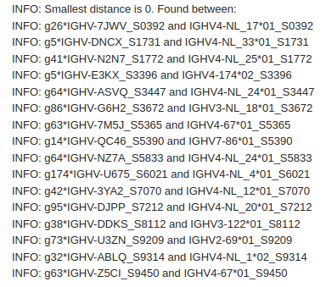
16 novel alleles are identical to alleles in the extended KIMDB

Slide 3
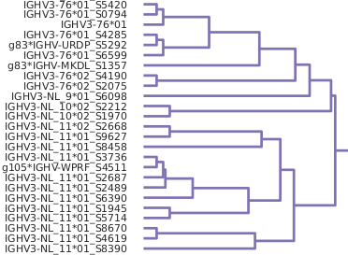
*

Slide 4
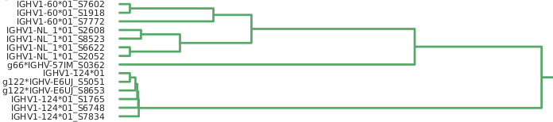
*

Slide 5
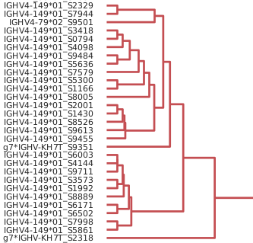
*

Slide 6
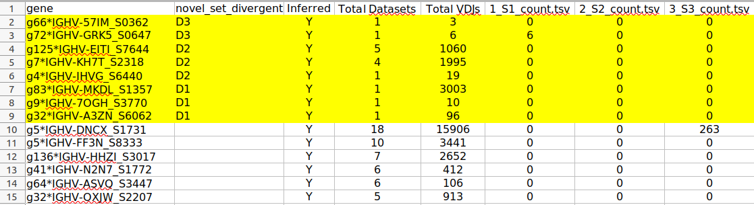
*
*
*

Slide 7
Conclusion – from brief glance
96 alleles
16 identical to KIMDB extended
Most of the remainder within the expected range for known genes
Some divergent sequences – possibly additional genes but low allele numbers?
Very divergent sequences may be fale positives
(very low counts, or small number of cases)

